Slide 1
Chapter 09 Exceptions Hierarchy and Types
FALL 2021

Slide 2
Throwable
The Throwable class is the superclass of all errors and exceptions in Java language.
Only objects that are instances of this class (or one of its subclasses) are thrown by the Java Virtual Machine or can be thrown by the Java throw statement.
Similarly, only this class or one of its subclasses can be the argument type in a catch clause. For the purposes of compile-time checking of exceptions.

Slide 3
Throwable Useful Methods
printStackTrace ()
Prints method call stack
getCause ()
Obtains the cause of the exception
getMessage ()
Returns a descriptive string

Slide 4
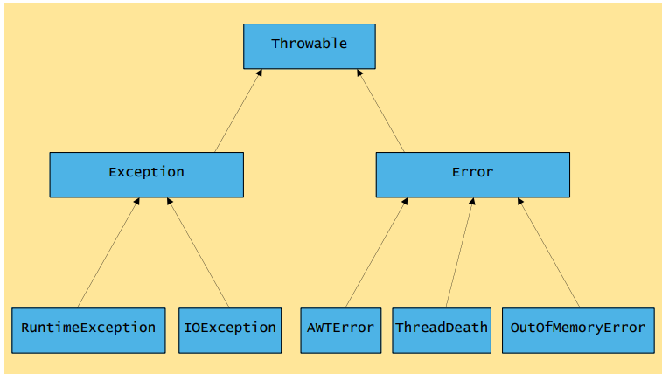
Inheritance hierarchy for class Throwable

Slide 5
Java Exception Hierarchy
Superclass Throwable
Subclass Exception
Exceptional situations
Should be caught by the program
Subclass RuntimeException
Should not be caught by a class
Subclass Error
Typically, not caught by the program (Runtime exceptions)

Slide 6
User Defined Exceptions
Most of the times when we are developing an application in Java, we often feel a need to create and throw our own exceptions
These exceptions are known as User Defined or Custom Exceptions.

Slide 7
Defining New Exception Types
Create a class that extends java.lang.Exception
Declare your method to throw this exception using the throws clause
Create an instance of this exception and throw it in the right place using throw statement.

Slide 8
Java Exceptions – Types
Java provides two main exception types: runtime exceptions and checked exceptions
Two aspects differentiate runtime exceptions from checked exceptions: mechanical and logical

Slide 9
Mechanical Aspects of Exceptions
Runtime exceptions:
A method signature does not need to declare runtime exceptions
A caller to a method that throws a runtime exception is not forced to catch the runtime exception
Runtime exceptions extend from java.lang.RuntimeException or java.lang.Error
Checked exceptions:
A method must declare each checked exception it throws
A caller to a method that throws a checked exception must either catch the exception or throw the exception itself
Checked exceptions extend from java.lang.Exception

Slide 10
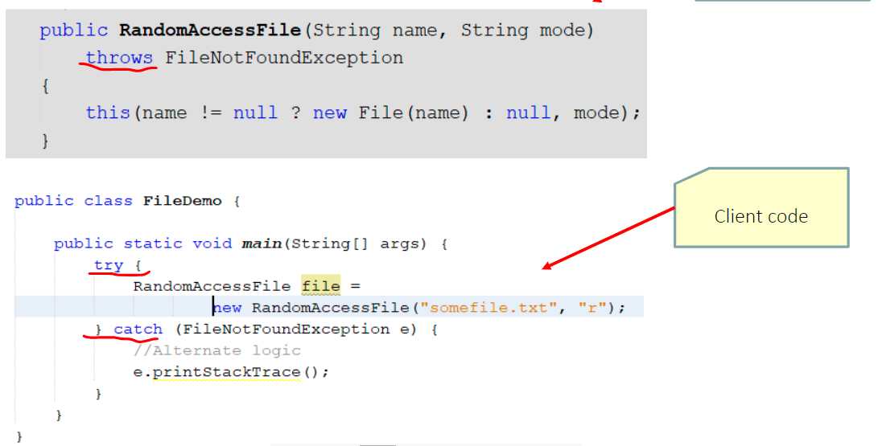

Slide 11
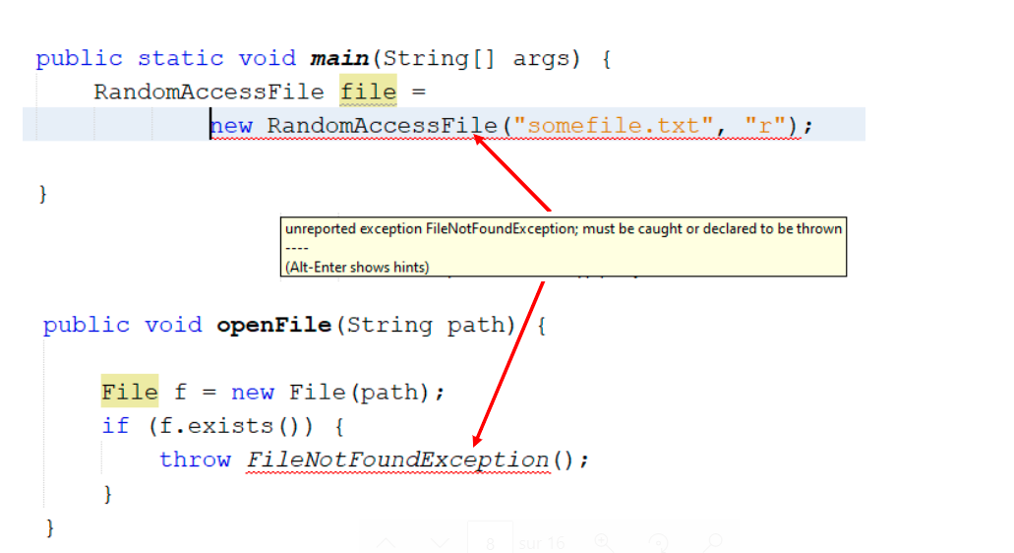

Slide 12
Runtime Exceptions Examples
This includes
Arithmetic exceptions (such as dividing by zero)
Pointer exceptions (such as trying to access an object through a null reference)
Indexing exceptions (such as attempting to access an array element through an index that is too large or too small)

Slide 13
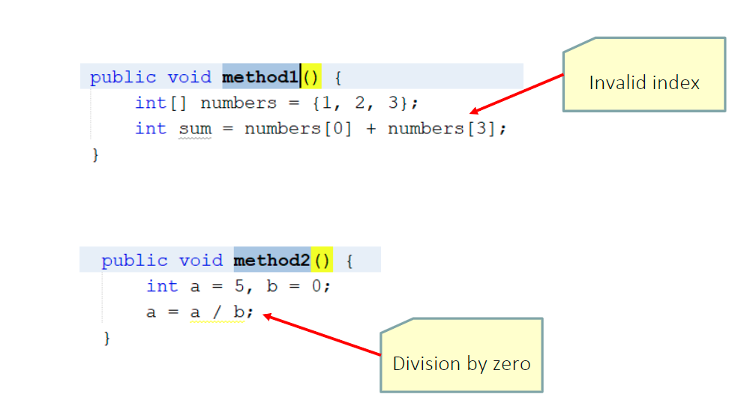

Slide 14
Logical Aspects of Exceptions
Checked exceptions
Indicate an exceptional condition from which a called can conceivably recover.
Force to catch the exception and do something about it.
Runtime exceptions
Indicate programmatic errors from which a caller cannot normally recover
It is best NOT to catch runtime exceptions, instead you should allow runtime exceptions to bubble up to where you can see them.
Try to prevent them from happening in the first place.

Slide 15
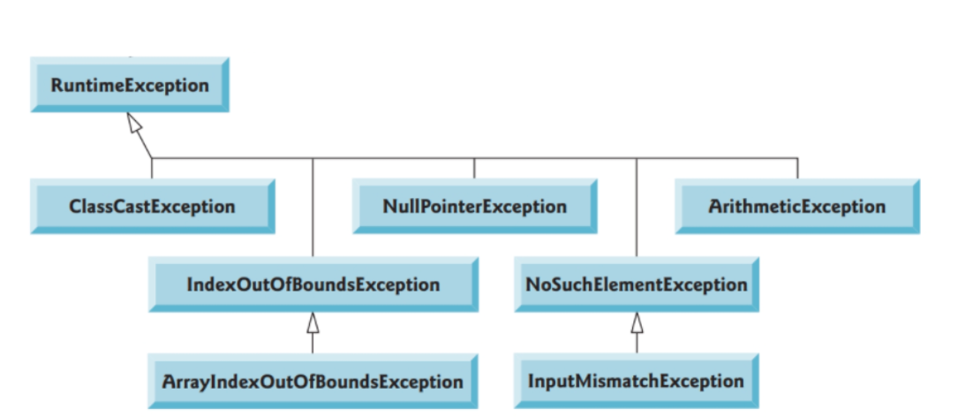
Examples of Runtime Exceptions

Slide 16
Difference between Error and RuntimeException
RuntimeException
“unchecked”, thus need not be in “throws” clause
Also can occur almost anywhere, e.g., ArithmeticException, NullPointerException, IndexOutOfBoundsException
Try to prevent them from happening in the first place!
Error
“unchecked”, thus need not be in “throws” clause
Serious system problems (e.g., ThreadDeath, OutOfMemoryError)
It is very unlikely that the program will be able to recover or prevent, so generally you should not catch these.

Slide 17
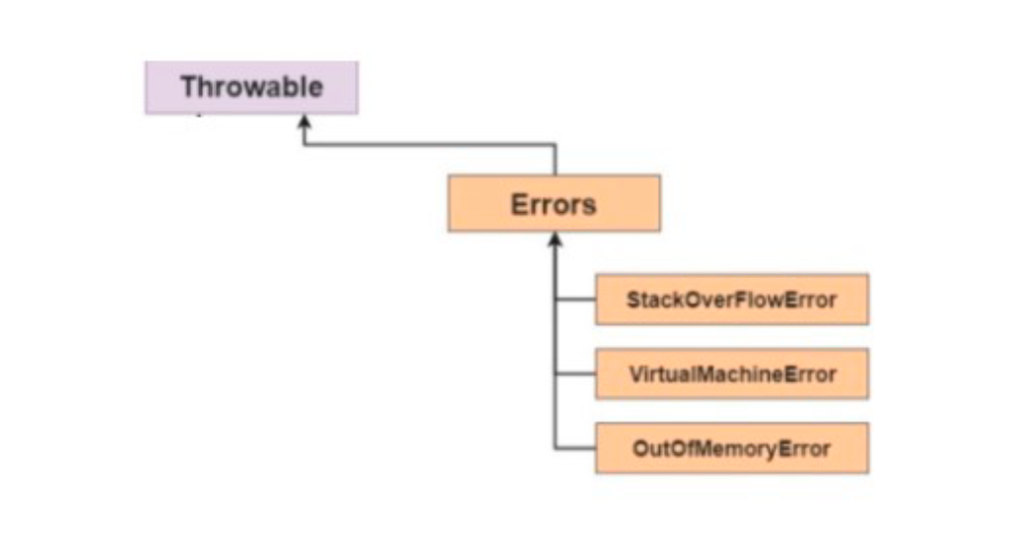

Slide 18
